Slide 1

Settlements Process

Slide 2
Overview:
Settlement is a process of working with Customers and Vendors with the goal is to clear all the outstanding the Citation for the customers, this process involves
Step1: Contacting the vendor with vehicles and citations information.
Step2: Receiving from vendor, all the outstanding citation with the backup transactions details.
Step3: Analyzing is the process of three categories by received Documents from Vendor for
1.Customer Approval Transactions
2.Payable Transactions
3. Disputable Transactions
Step4: Contacting Vendor with the “Payable transactions” to pay on time to avoid “late fees and fines”.
Step5: Contacting Vendor with the “Disputable Transactions” along with Police Report , DMV Report, Sold Vehicle Report for removing customer liability.
Step6: Contacting Customer with the “Customer Approval Transactions” to decide whether the transaction to make Payment (Step4)or Dispute(Step5).
Step7: Following up with the vendor for Step4 & 5 to be completed
Step8: Following up with the Customer for Customer Approval and Customer Backups (Police Report , DMV Report, Sold Vehicle Report)
Step9: Paying vendor for all the “Payable Transactions”.
Step10:Sending Paid Transactions for Billing and Invoicing.

Slide 3
STEP 1: Contacting the vendor with vehicles and citations information Overview:
1. Collecting UTN-BILL-SETTLMENET bills from Payment Team via Payment Portal.
- In BillPay Portal {Bill's PROCESS:“UTN-BILL-SETTLEMENT” }. 2. Moving Collected bills to STML-VENDOR-REQUEST\PENDING Stage by Creating a Settlement Request Batch for each vendor.
Settlement Module is yet to be developed in BillPay Portal. Once the settlement module is prepared, a settlement task will be created in Task portal for each of the Settlement Batch Request automatically. All the Bills that are picked up for the settlement request will be linked to the Settlement Task for Easy Tracking via Task Portal. Whenever bills are moved, system should automatically identity the pending Settlement Requests ID and add those bills under that collection. If the system could not find any Pending Settlement Request, then new Settlement Request record should be created in DMS database/Settlement table. Bills are Category = STML , Process = STML-VENDOR-REQUEST, Stage = PENDING
3. Extracting the Transactions and its vehicle or plate details for batch request
Via Settlement Details Page, User will be able to generate Vendor report, Once the request is generated, report should be attached to the Task and update the Stage under {STML-VENDOR-REQUEST\REPORT-GENERATED}
4. Emailing the Vendor, with the report for settlement
Tasks are updated to {Stage:STML-VENDOR-REQUEST\SENT}
5. Track and follow-ups via task portal
Process Management: 1. Every Vendor's Settlement process is different. System should capture Vendor EmailID, phone number for settlement process.

Slide 4
STEP 2: Receiving from vendor, all the outstanding citation with the backup transactions details.
Overview:
Receiving vendor responses (Excel, CSV, PDF) containing details of all outstanding citations and their backup documents.
Updating the status of linked bills to {Stage: STML-VENDOR-RESPONSE\RECEIVED} once the response is uploaded.
Receiving more additional transactions and bills from vendors sometimes than what was originally requested.
Moving the additional data directly for "STEP-3"
Existing Bills in BillPay should be updated as: {Category = STML, Process = STML-VENDOR-REQUEST, Stage =STML-VENDOR-RESPONSE , StagePhase – RECEIVED}.
Attaching the vendor response files to the Settlement Task in the Task Portal and Moving the Task stage to {Stage: STLMT-ANALYSIS\ANALYSIS-PENDING} for further processing in Step-3
Updating the TaskID in all BillID in BillPay Portal
Process Management:
Every vendor has different response timelines; system should capture SLA (days/hours) for each vendor in Vendor Master. The SLA must be tracked from request sent to response received, with alerts/escalations on breach

Slide 5
STEP 3: Analyzing is the process of three categories by received Documents from Vendor
Overview:
Loading the vendor response file into the system by placing it into the designated settlement folder
{ Process = STLMT-ANALYSIS ; Stage = " VALIDATE VENDOR FILE" Stage Phase = "VERIFIED/"MISSING INFO"}.
"Proceeding to "Step-1" when the Stage Phase is marked as MISSING INFO."
Extracting updated analysis results from the System.
Analyzing Check List :
Derive Vehicle Number , Derive Unit ID, Pate ID,
Valid Plate/ Invalid Plate
Already Billed
Plate Never Received
Before Active
After Inactive
Plate Active
Unit Active Plate Inactive
Transactions occurs during Plate Active Period
Transactions occurs during Unit Active Period
{ Process = STLMT-ANALYSIS ; Stage = "Report Generation" ; Stage Phase = "Generated "}.
Separating transactions into three new processes ,For each Process New Child Task should be Created and linked to the Parent Task.
STML-CUSTOMER-APPROVAL-TRANSACTIONS
STML-PAYABLE-TRANSACTIONS
STML-DISPUTABLE-TRANSACTIONS
Waiting for "Settlement Team Lead" to begin the review of the generated report
{ Process = STLMT-ANALYSIS ; Stage = "Report Generation" ; Stage Phase = "Review Pending" }.
Confirming that "Settlement Team Lead" have reviewed and accepted the report
{ Process = STLMT-ANALYSIS ; Stage = "Report Generation" ; Stage Phase = "Approved" }.
Receiving feedback or objections from "Settlement Team Lead" regarding the report
{ Process = STLMT-ANALYSIS ; Stage = "Report Generation" ; Stage Phase = "Rejected" }.

Slide 6
Process Name | Condition (When to Move Here) | Action / Next Step
STML-CUSTOMER-APPROVAL-TRANSACTIONS | Vehicle not active during transaction period(Grace Period) Plate not in customer approval list Prior Transactions should be approved by customer | Create task under Customer Approval process, attach bills/documents
 | Settlement team is contacting customer for decision | Customer decides: PAY → move to Payable process, DISPUTE → move to Disputable process
 | Plate Never Received and not in the Approval List | Close approval task; route transaction to correct process
STML-PAYABLE TRANSACTIONS | Vehicle active during transaction period Plate active (current or before) Plate in approval list marked as " PAY" | Create task under Payable process
 | Vendor contacted for payment | Track payment status
 | Payment made to vendor | Forward to billing/invoicing (Step-9 & Step-10)
STML-DISPUTABLE TRANSACTIONS | Plate exists in approval list and marked as DO NOT PAY. | Create task under Disputable process
 | Vendor contacted with backup docs (Police Report, DMV Report, Sold Vehicle Report) | Track dispute resolution
 | Vendor confirms removal of liability | Close disputable task; update customer & system

Slide 7
STEP 4: Contacting Vendor with the “Payable transactions” to pay on time to avoid “late fees and fines
Plate Verification
First, check whether the plate is active or included in the list of approved plates.
If the plate meets the criteria, contact the vendor for confirmation.
During this verification, also confirm with the vendor if there are any new transactions recently received for the same plate. This ensures that all possible transactions are captured before proceeding further.
Duplicate Validation
Once verification is complete, initiate the duplicate check process on the file.
The duplicate check is carried out using the following key parameters:
Plate Number – ensures identification is plate-specific.
State – validates jurisdiction/state-specific entries.
Transaction Date – ensures transactions from the same day are not repeated.
Transaction Time – adds precision to the validation by capturing exact transaction time.
This process helps to filter out repeated entries and prevents duplicate billing or payment processing.

Slide 8
Post-Validation Process
After completing the duplicate check, classify the transactions accordingly:
Valid Transactions → Move forward to the Payment Process for settlement.
Duplicate Transactions → Flag them under the Duplicate Resolution Process to avoid incorrect or repeated payments.

Slide 9
STEP 5: Contacting Vendor with the “Disputable Transactions” along with Police Report , DMV Report,Sold Vehicle Report for removing customer liability.
Identify Invalid Transactions
Review all transactions that are marked as invalid during the validation process.
These invalid transactions are to be moved into the Disputable Transaction category for further investigation.
Vendor Backup & Documentation
For each disputable transaction, request supporting backup documents from the vendor.
The vendor should provide one or more of the following documents to support the dispute:
BOS (Bill of Sale)
Police Report
Sold Report
Vehicle Report
These documents help determine whether the liability belongs to the customer or should be removed from their responsibility.

Slide 10
Bill of Sale (BOS) Handling
If the vehicle already has a valid Bill of Sale (BOS):
Move the transaction directly into the Dispute Category with the attached BOS.
If the vehicle does not have a BOS:
Contact the vendor and request accurate and complete documentation.
Ensure the proper BOS or other valid proof is obtained to process the dispute.
Customer Liability Adjustment
Once verified documentation is obtained, remove the disputed transaction from the customer’s liability.
Ensure that the records are updated to reflect that the customer is no longer responsible for the invalid charge.
Disputable Transaction Processing
All verified disputable transactions (with BOS, Police Report, or related documents) should be finalized under the Dispute Transaction Process.
In cases involving DMV (e.g., Sold vehicles reported to DMV), ensure the DMV-provided data is also captured and recorded to strengthen the dispute resolution.

Slide 11
STEP 6: Contacting the Customer with the “Customer Approval Transactions” to decide whether to make aPayment (Step 4)orDispute(Step 5).
1: Collecting bills under process "TRANSACTION APPROVAL and PLATE/UNIT APPROVAL.
In the BillPay category: UTN BILL SETTLEMENT PROCESS: UTN BILL APPROVAL, stage: CUSTOMER APPROVAL, stage phase: TRANSACTION APPROVAL /PLATE/UNIT APPROVAL
2 : Moving collected bills to the under category STML, Process -SETTLEMENT CUSTOMER APPROVAL, and under stage -TRANSACTION APPROVAL /PLATE APPROVAL
3 : Extract the reports for Transaction and plate approval details to approach the customer.
4 : Contacting a customer to get the approval for the transaction, plates inactive /PNF to clear outstanding citations.
5: Moving Customer Accepted transactions and plates to Next Process’s –“PAYMENT " to make payments for all customer approvals, and then customer rejected transactions, plates are moved to Process " SETTLEMENT DISPUTES ".
STEP 7: Follow up with Vendor for Step 4 & 5 to complete.

Slide 12
STEP 8: Following up with the Customer for Customer Approval and Customer Backups (Police Report , DMV Report, Sold Vehicle Report)
Step 1 : Collecting details " Customer Approval " to follow up with the customer.
Step 2 : Contacting the customer for BOS for Vehicle sold, FIR copy for Vehicle stolen, and DMV reports. Once image backup for these disputes are received, change the stage accordingly -choose Stage -CUSTOMER CONTACT, Stageclass -BOS/POLICE REPORTS/DMV REPORTS, and stage phase BOS received/Police reports received/DMV received.
Step 3 : Move image backup received items to Process "SETTLEMENT DISPUTE " to stage " CONTACT VENDOR " to remove the Vehicle/plates from the Vendor settlement file Details permanently .
Step 4 : Continue the follow-up until we receive the Image backup from the customer ( Step 2 and Step 3 ).

Slide 13
STEP 9: Paying vendor for all the “Payable Transactions” :
Overview:
1.Paying the bills that are under in “Customer Approval Accepted” and “Dispute Rejected” Bills are Approved by Onsite team.
1.1 - Bills that are under Category = “STML” , Process = “STML-CUSTOMER-APPROVAL” & “STML-DISPUTE”, Stages = “Transaction , Plate Approval”, Stage Phase = “Approval Accepted”
2. Assigning the Approved bills to the Settlement team for making a payment, through the BillPay Portal.
2.1 - Bills Assigned to the
3.Making the Vendor Payment through the Phone call method
4.Receiving the Payment Confirmation email from Vendor.
5.Sending the Formatting Paid file to the Billing Team.
6.Closing the Paid bills in the BillPay Portal.
Report Management:
1. Overall Customer Settlement for Date
2. Vendor wise payment Report
3. Vendor wise waive Report
- Batch wise Report
4. Approved for but not paid bills
5. Pending for Customer Approval (Inactive plates & PNR)
6. Waiting for Bill of sale from Customer
7. Paid but waiting for vendor confirmation
8. Paid bill ready for billing (Bills Still in Formatting Stage)
9. Paid bills Moved to Billing

Slide 14
Understanding the Settlement Process
Objective: Fee Waiver
Scope: Fines & Fees Only
Critical Time-Sensitivity
The core goal is to waive high fees by securing vendor approval, primarily targeting fines and service charges, not the original due amount.
Discounts exclusively apply to fines and service fees, ensuring the principal debt remains intact.
The settlement must conclude within a strict 10-business-day window. Failure to meet this deadline results in a paper notice for non-payment, rendering the settlement void.
This process is crucial for optimizing our financial operations and maintaining strong vendor relationships.

Slide 15

CHAPTER ONE - 3 P
People, Process, Product

Slide 16
Rules For Product Management
1
3 P --> People | Process | Product
2
Baas Setup
People ,Process, Product are involved in any process. we
Need to list out the all contacts for People .
Need to define the Process.
List the Products used for the applications
Define the Process in Workflow and manage that in Task Application and adhere to Service Level Agreements (SLAs) for each step. This ensures timely processing and avoids penalties. Critical tasks include settlement analysis by Alita,(Bala, and Ahimsa).
payment processing by Ganga, Sarath, and Gomathy.
3
Task Management
1. Define SLA (Service Level Agreement)
SLA specifies expected timelines for each settlement step.
2. Escalation
If SLA is not met, the issue is escalated to higher authority.
Ensures quick resolution and avoids bottlenecks.
3. Report
Regular reporting of SLA adherence and escalations.
Used for monitoring, decision-making, and performance improvement.
4
Process Automation
Final process –core agenda is convert manual process in to automation.

Slide 17



Understanding the 3P's
People (Resources)
Vendor (UTN)
Internal Team (Alita, Bala, Ahimsa, Bhagya, Ganga, Sarath, Gomathy)
Customer -
Process
STML VND Request
STML Dispute
STML VND Analysis
STML Billed
STML Customer Approval
Bill Closure
STML VND Payment
Product (Software/Tools)
Billpay
Task
Fleet
A clear understanding of each component ensures a smooth and efficient settlement workflow.

Slide 18
Process Automation: Enhancing Efficiency
Automating key steps in the settlement process will reduce manual errors and accelerate completion.
This streamlined approach minimizes human intervention where possible, freeing up team members for more complex tasks.

Slide 19



Key Takeaways: Empowering Our Teams
Cross-functional Collaboration
Adherence to Deadlines
Continuous Improvement
Success hinges on seamless coordination between Product, Operations, and specific team members like Alita, Bala, and Ganga. Clear communication channels are vital.
The 10-business-day window is non-negotiable. Proactive management of tasks and timely approvals are critical to avoid forfeiture of fee waivers.
Regular review of SLAs, escalation protocols, and reporting will identify bottlenecks and areas for further optimization in the settlement process.
By focusing on these areas, we can significantly improve our settlement outcomes.

Slide 20
Process for Settlement.
1.Settlement Request
2.Settlement Analysis

Slide 21
Settlement Request:
Step 1: Image Collection
Images are received via the FTP server.
Stored in a folder named “Unpaid.”
Step 2: Identify Settlement Vendor
Vendors include NJ EZPASS, PA TURNPIKE, TX NTTA, and CA TCA (Toll Authorities).
If the file belongs to NTTA, it can be directly taken up as a settlement.
Step 3: Alternate File Receipt
In some scenarios, files for PA TURNPIKE are received directly via email from the vendor.
Step 4: File Processing
The file containing transaction details is collected.

Slide 22
Step 5: Request Submission
A request is raised to the respective settlement vendor with the following details:
Account Number / Zip Cash Account ID
Plate Number
State

Slide 23
2.Settlement Analysis:
Step 1: File Formatting & Loading The received file is first formatted into the required structure and then loaded into the system. Successful loading ensures that the data is ready for validation.
Step 2: Data Validation Once the file is loaded, the system validates the data to check for duplicate transactions. This validation is carried out using the following criteria: Plate, State, Date, Time, and Location.
Step 3: Report Generation After validation, a report is generated to capture the status of each transaction. This report highlights duplicates, valid records, and exceptions.

Slide 24
2.Settlement Analysis:
Step 4: Already Billed Transactions If any transaction is identified as already billed, a request is raised to the vendor to remove those records from further processing.
Step 5: Transactions That Need Payment For records that require payment, the system checks the plate status to determine the next step.
If the plate is valid, the transaction is moved to the Payment process.
If the plate is not valid, the transaction is moved to the Dispute process.

Slide 25
3.Settlement Customer Approval
1. Transactional Approval
When the SLA terms for billing are not met, we must obtain approval from the Customer .
Example: For Penske, all billings and payments must be completed within 18 months.
Possible Outcomes:
Accepted → Customer has approved the transaction and it can move forward.
Rejected → Customer has rejected the transaction.
2. Plate Approval
If a plate is found to be inactive or flagged as PNF (Plate Not Found), wewill reach out to the customer to confirm its current status.
Possible Outcomes:
Accepted → Customer has confirmed the plate as valid.
Rejected → Customer has rejected the plate as invalid.

Slide 26
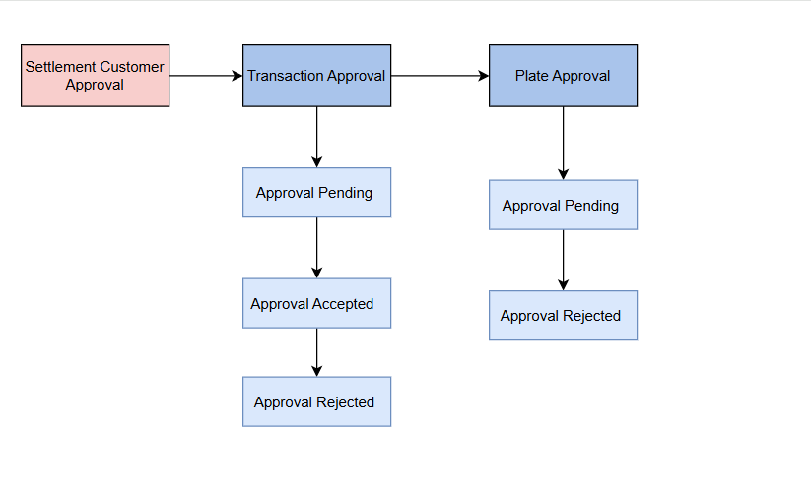
Settlement Customer Approval​

Slide 27
Settlement Dispute
4.Settlement Disputed
Customer Contact
If a vehicle linked to a plate has been sold, we will contact the customer to obtain the Bill of Sale (BOS) as proof.
Steps in this stage:
Request BOS → Ask the customer to provide an image/backup copy of the BOS for cases where plates are inactive/PNF.
Waiting for BOS → Hold action until the customer provides the requested BOS.
BOS Received → Confirm receipt of the BOS copy from the customer for further processing
Vendor Contact
Once the BOS has been received, we will reach out to the vendor to remove the transaction associated with the plate from the settlement file.
Possible Outcomes:
Dispute Accepted → Vendor agrees to remove the disputed transaction.
Dispute Rejected → Vendor rejects the dispute, and further resolution may be required..

Slide 28
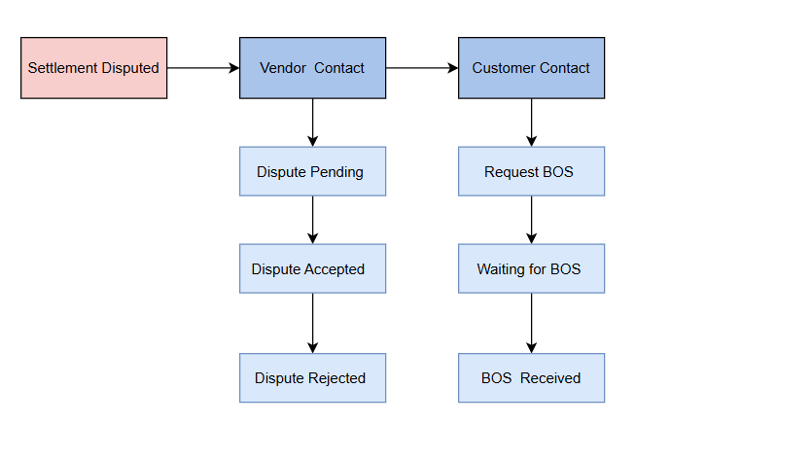
4.Settlement Disputed​

Slide 29
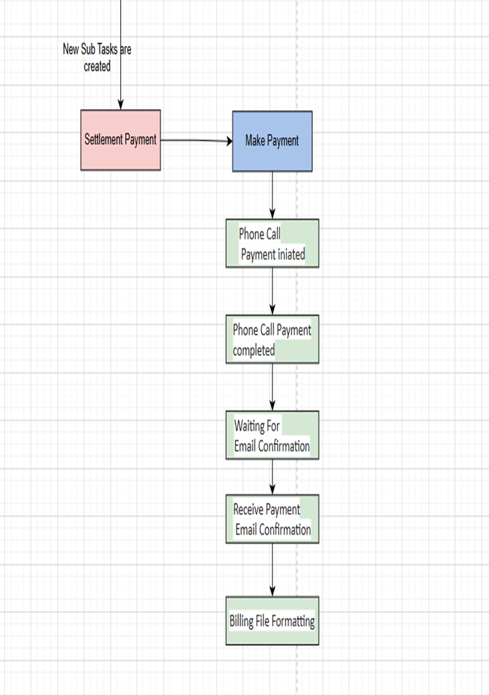
5.Settlement Payment:
• Once File approved by the Onsite Team, they start making the payment.
• Payment method by the phone call payment
• Payment gets approved
• Payment Pending
• Once Payment Completed , we receive the payment confirmation email from toll authority.
• After Completed the Payment , file should be formatted and email to the Billing Team

Slide 30
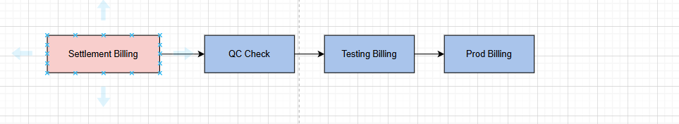
6.Settlement Billing: • Once the Payment completed , the payment team share the formatted file to the Billing team.
• Billing team do the QC check the received file and moved to test billing.
• Once test billing completed , moved to file prod billing.
• After Billing Completed , they send an email with Billing file to Finance team.

Slide 31

Thank You
For a more detailed discussion or specific process inquiries, please reach out to the Product and Operations teams.

